Slide 1
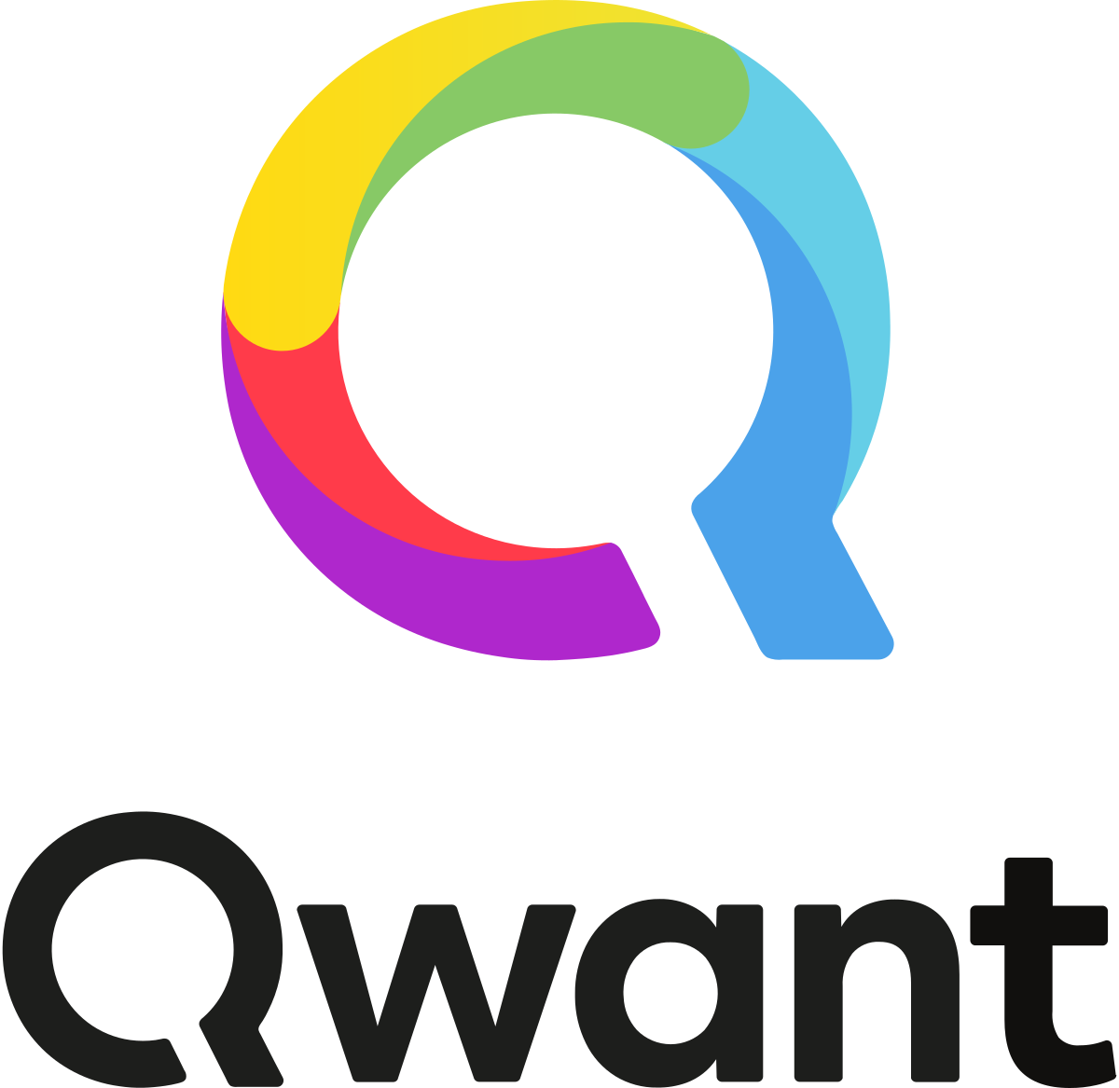
The research project SocialTruth, promoted by Zanasi & Partners and under the coordination of the Greek Institute of Communication and Computer Systems, has been accepted by the European Commission and will be funded under the Horizon 2020 programme.
SocialTruth (Open Distributed Digital Content Verification for Hyper-connected Sociality) is a research project having the objective of developing a new and effective approach to content verification in order to counter the spread of fake news through online channels.
The extreme growth and adoption of Social Media, in combination with their poor governance and the lack of quality control over the digital content being published and shared, has led information veracity to a continuous deterioration.
Most commonly used approaches entrust content verification to a single centralised authority, although lacking resilience towards attempts to successfully “game” verification checks, and making content verification difficult to access and use. In response, the ambition of the SocialTruth project is to create an open, democratic, pluralistic and distributed ecosystem that allows easy access to various verification services (both internal and third-party), ensuring scalability and establishing trust in a completely decentralised environment.
The distinctive advantages of the approach proposed in SocialTruth are:
avoidance of vendor lock-in through access to configurable combinations of various content analytics and verification services (with support for text, image and video content) via standard Application Programming Interfaces;
distributed trust and reputation establishment powered by blockchain technology, ensuring immutability and auditability, revealing information cascades and empowering an information veracity observatory;
integration of lifelong learning approach for detection of new paradigms of fake news;
easy interaction through a Digital Companion that allows convenient everyday access of individual users to verification services from within their browsers.
SocialTruth is expected to bring benefits to a wide array of actors, such as:
individual users to verify the validity of Social Media content and prevent misinformation spread;
media organisations, content authors and journalists to boost their investigative capabilities by enabling improved cross-checking of various multimedia information sources;
search engines, Social Media platforms and e-advertising networks to improve information veracity and contribute into a more sustainable and quality-oriented web and social media ecosystem.
Zanasi & Partners (http://www.zanasi-alessandro.eu) is an Italian research and advisory company specialised in security and defence.
SocialTruth project partners

